Slide 1
hotel booking

Slide 2
Description
Our project, aims to transform the online hotel booking experience by integrating cutting-edge technology and user-centric design. In a world where convenience and efficiency are paramount, Seamless Stay offers a comprehensive platform that simplifies the process of finding, booking, and managing hotel accommodations.

Slide 3
Functional requirement
Functional Requirements:User Registration: Allow users to create accounts with personal information.Hotel Search: Provide a search feature to find hotels based on location, dates, and preferences.Room Reservation: Enable users to reserve rooms based on availability and preferences.Booking Management: Allow users to view, modify, and cancel their bookings.Payment Processing: Integrate secure payment methods for booking confirmation.Review and Rating: Allow users to leave reviews and ratings for hotels they have stayed in.Admin Dashboard: Provide administrators with a dashboard to manage hotel listings, bookings, and user accounts.Notifications: Send email or SMS notifications to users for booking confirmations, reminders, and updates.Multi-language Support: Support multiple languages to cater to international users.Mobile Compatibility: Ensure the platform is responsive and works well on mobile devices for on-the-go bookings.

Slide 4
Non-Functional requirement
Performance: Ensure fast loading times and response rates, even during peak usage.Security: Implement strong encryption and security measures to protect user data and payment information.Scalability: Design the system to handle a large number of users and transactions as the platform grows.Reliability: Minimize downtime and ensure the system is available 24/7.Usability: Design an intuitive user interface for easy navigation and booking process.Compatibility: Ensure compatibility with various web browsers and devices.Accessibility: Design the platform to be accessible to users with disabilities, complying with accessibility standards.Data Backup and Recovery: Implement regular backups and a robust recovery plan to prevent data loss.Compliance: Ensure compliance with relevant regulations and standards, such as GDPR for data protection.Performance Monitoring: Implement tools for monitoring system performance and user interactions to identify and address any issues promptly.

Slide 5
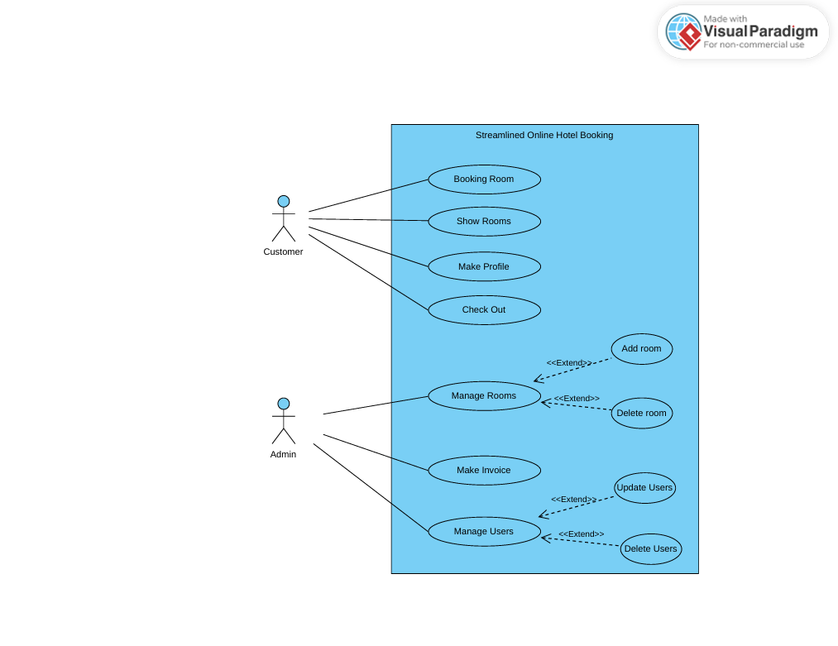
USE CASE Diagram

Slide 6
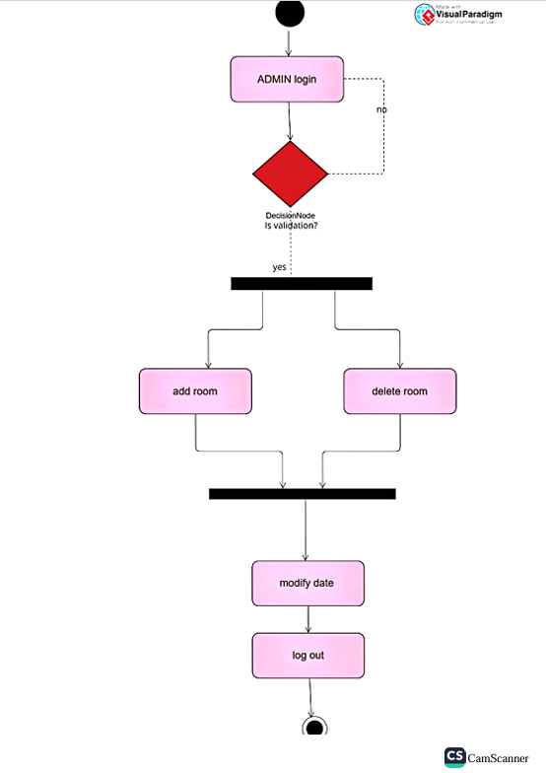
ACTIVITY DIAGRAM

Slide 7
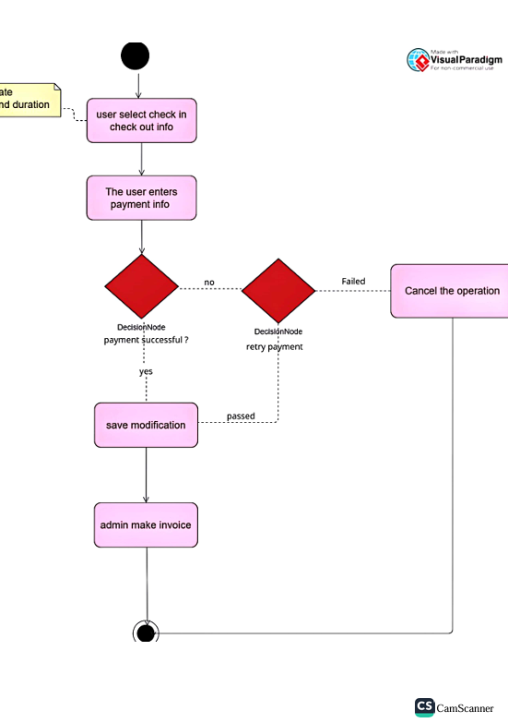
ACTIVITY DIAGRAM

Slide 8
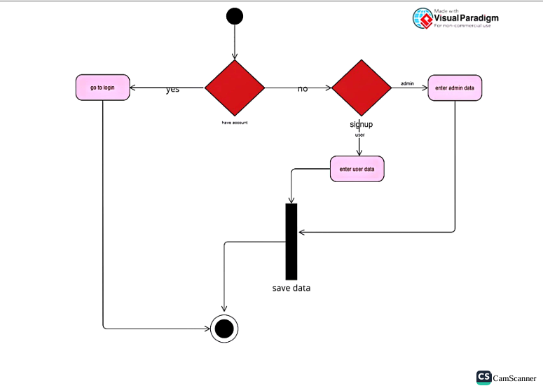
ACTIVITY DIAGRAM

Slide 9
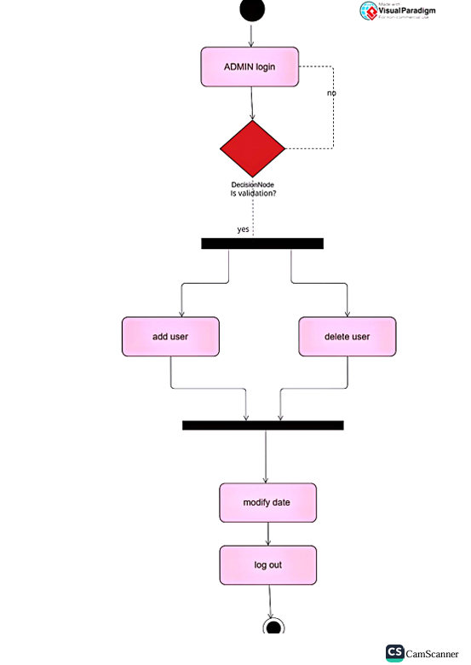
ACTIVITY DIAGRAM

Slide 10
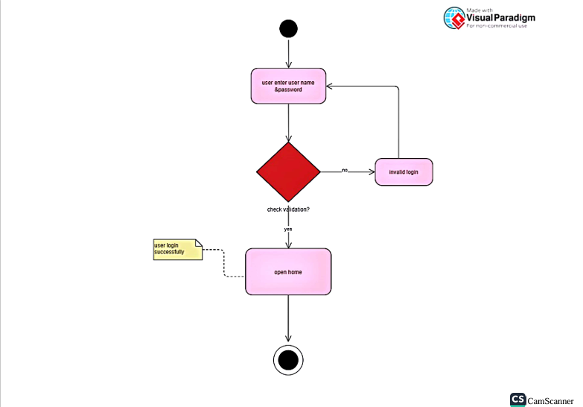
ACTIVITY DIAGRAM

Slide 11
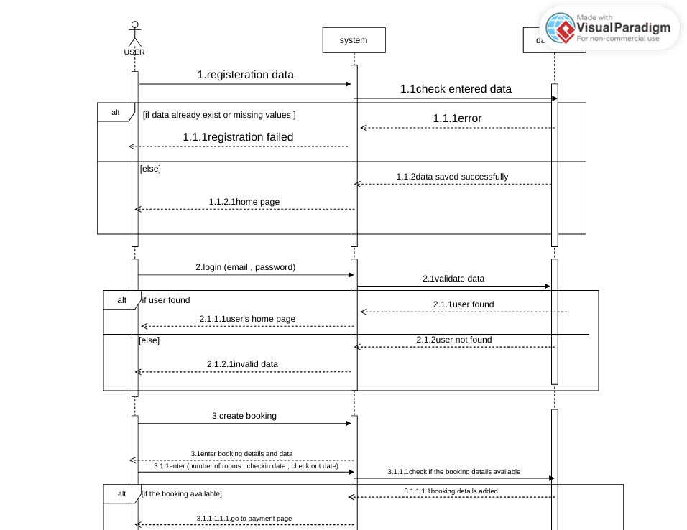
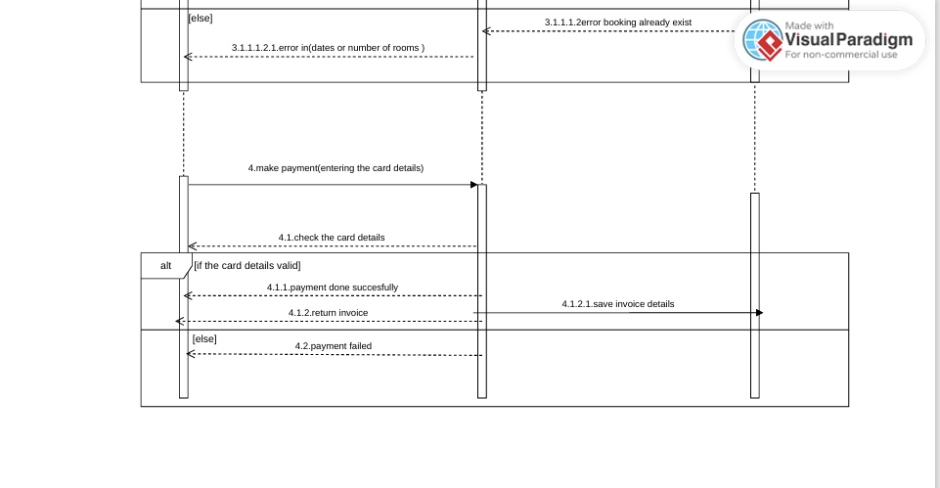
SEQUENCE DIAGRAM

Slide 12
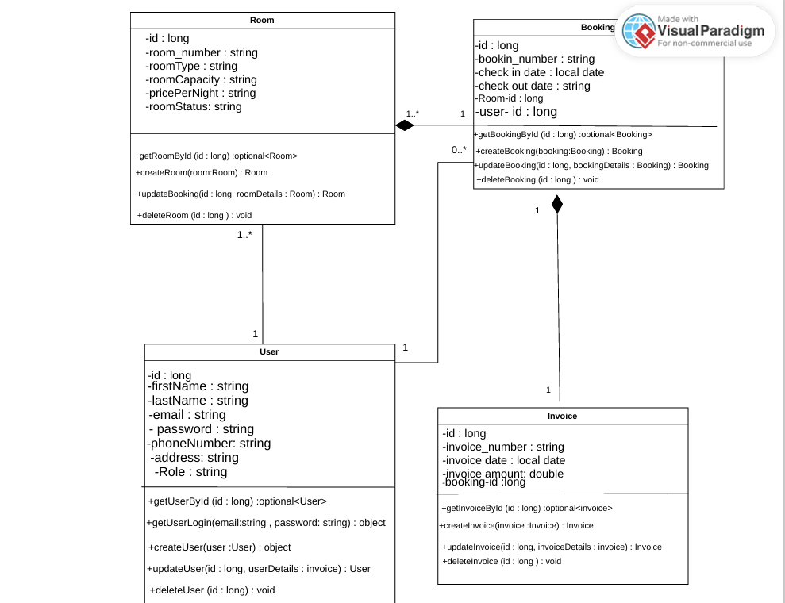
CLASS DIAGRAM

Slide 13
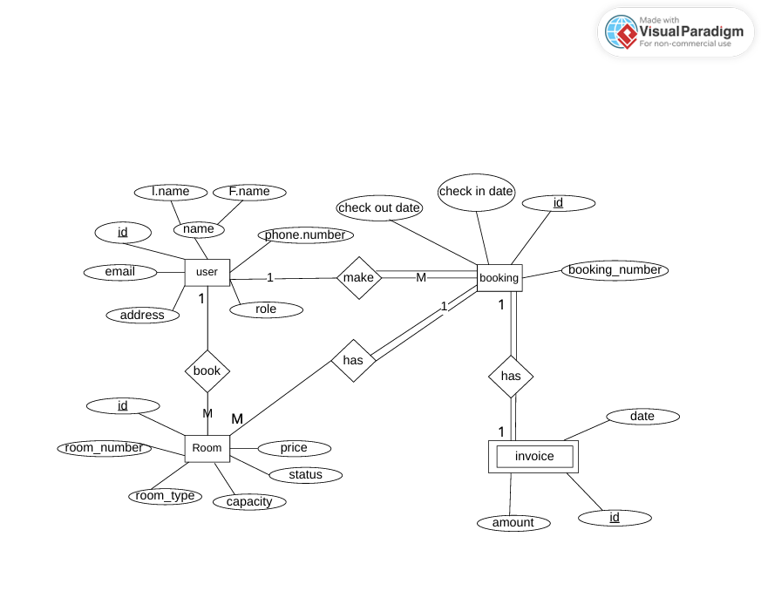
ERD DIAGRAM

Slide 14
ROOM OCL

Slide 15
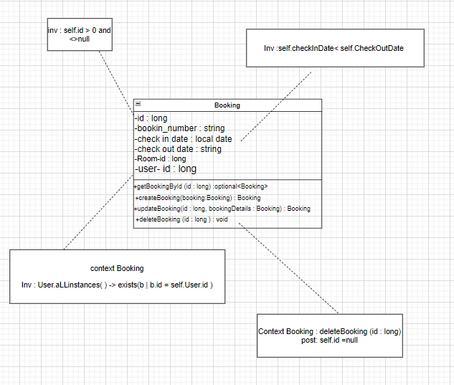
BOOKING OCL

Slide 16
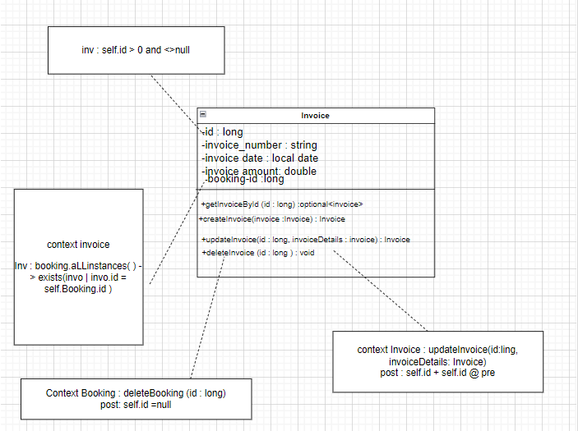
INVOICE OCL

Slide 17
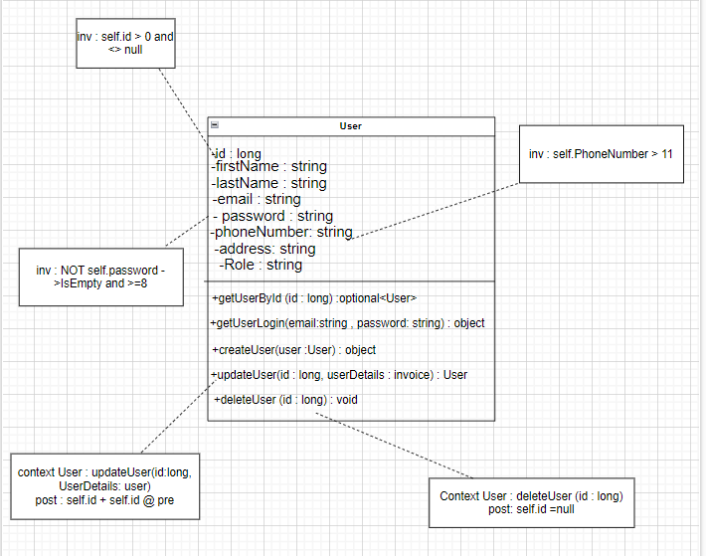
USER OCL

Slide 18
Thank you

